Slide 1
Structured Database and API to enable multilingual Search of different Political Actors with Performance Analysis of different approach
Submitted By:
Subhasis Dutta-sxd150830
Jayprakash Rout-jxr152730
Priyanka Chadalavada-pxc162330
Sneha Ramesh Neranki-snr150130
Chandrika Cherukuri- cxc161530

Slide 2
Outline
Problem Statement
Architecture
Data Sets
Implementation
Performance
Experiments and Observation
Future Work
References

Slide 3
Problem Statement
Build a Integrated ETL(Extract Transform & Load) System, Consume data from Multiple source and expose a single API Interface
Do a performance Analysis and comparison using different method to create a relation table with many to many string comparison.
Identify unidentified data in the input dataset using Machine Learning.
Language identification of the given list of names in the JRC data. This will help us identify the different variates of the same name in different languages.

Slide 4
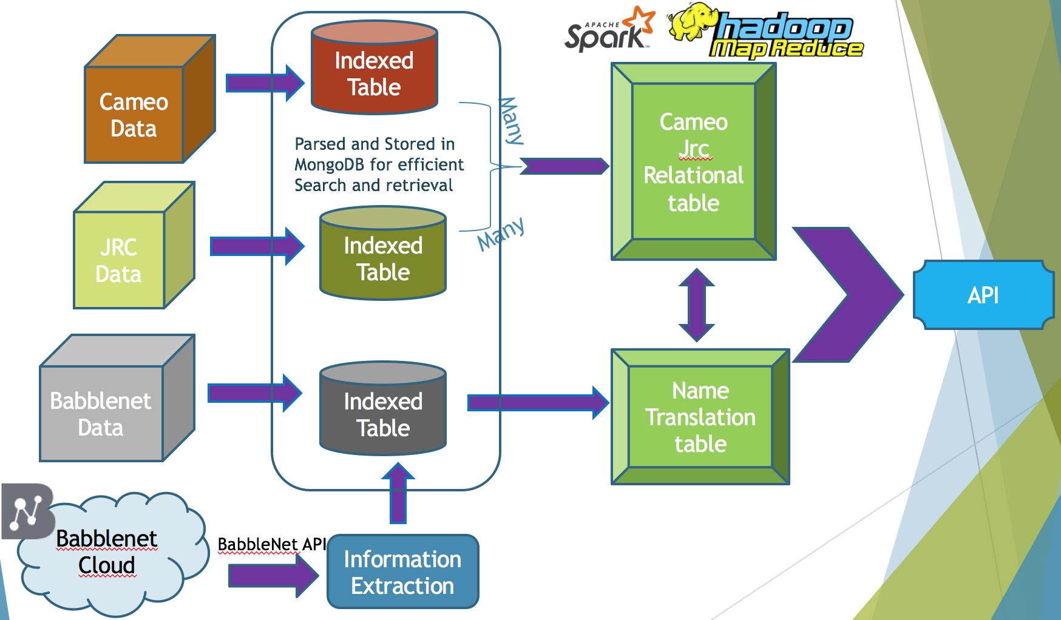
Architecture

Slide 5
Demo 1

Slide 6
CAMEO Data Set
Phoenix.agents.txt
Lines Processed for Cameo.Phoenix.agents is : 2292
Records created for Cameo.Phoenix.agents is : 1972
Phoenix.Countries.actors.txt
Lines Processed for Cameo.Phoenix.Countries.actors is : 54410
Records created for Cameo.Phoenix.Countries.actors is : 286
Phoenix.International.actors.txt
Lines Processed for Cameo.Phoenix.International.actors is : 7976
Records created for Cameo.Phoenix.International.actors is : 7526
Phoenix.MilNonState.actors.txt
Lines Processed for Cameo.Phoenix.MilNonState.actors is : 2680
Records created for Cameo.Phoenix.MilNonState.actors is : 959

Slide 7
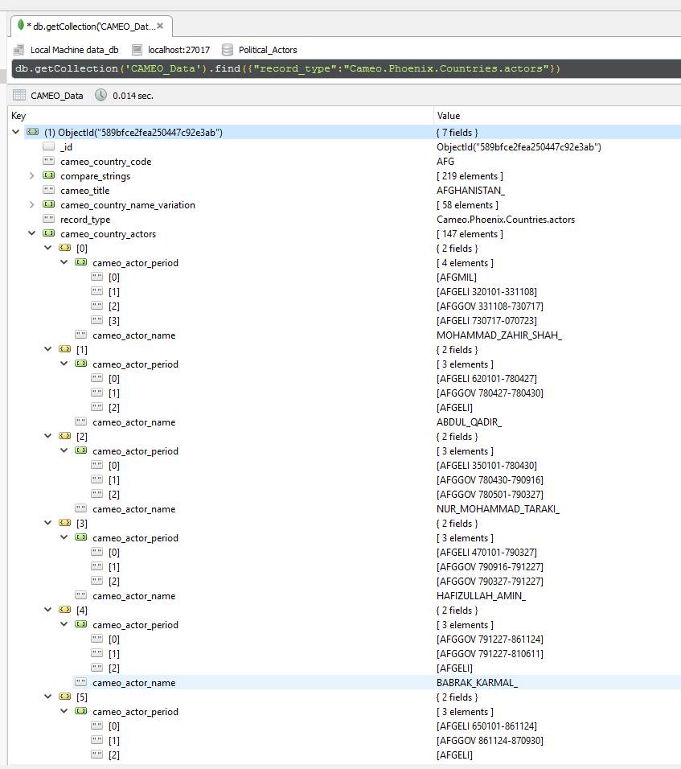
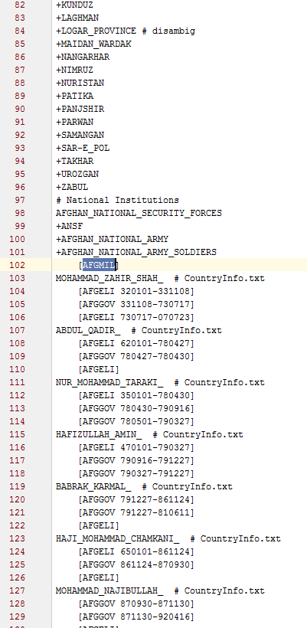
Phoenix.Countries.actors

Slide 8
JRC Names Data Set
Large-scale, multilingual news analysis combined with Wikipedia
Resulting in 318,694 person and organization names
About the same number of spelling variants written in
Over 20 different scripts mostly : Arabic, Bulgarian, Danish, Dutch, English, Estonian, Farsi, French, German, Italian, Norwegian, Polish,Portuguese, Romanian, Russian, Slovene, Spanish,Swahili, Swedish and Turkish
Script to move data into database to make it searchable and enhance with data from other sources.
Script takes 30 seconds to process 659,894 records and group them into separate documents in MongoDB collection.
With every new set of data the old collection can be removed and new data set can be quickly rebuild.
Ex – Barak Obama has 141 name variations in the data base

Slide 9
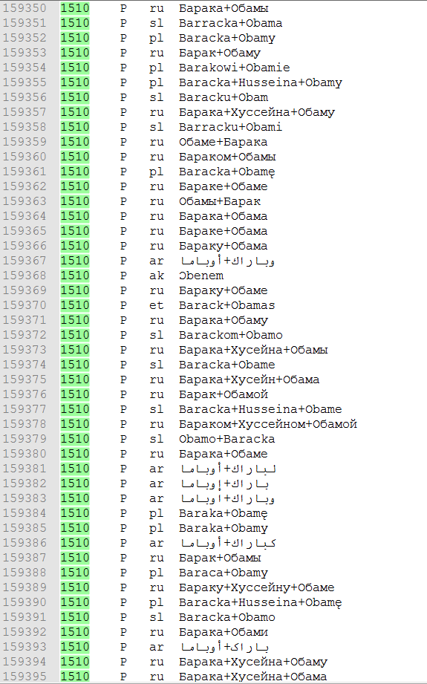
Unique Identifier
Name Variants
Type:
P – Person
O - Organisation
Language:
U – unknown
xx – ISO 639.2 code

Slide 10
BableNet API https://babelnet.io/v4/getSenses?word=donald_trump&lang=EN&pos=NOUN&filterLangs=AR&filterLangs=ES&key=284fd255-4315-4e6e-b6c9-f7a6409bc815
Given Name , Language of the name and Languages in which the conversion is required .
[ { "lemma":"دونالد_ترامب",
"simpleLemma":"دونالد_ترامب",
"source":"WIKIDATA",
"sensekey":"Q22686#1",
"language":"AR",
"pos":"NOUN",
"synsetID":{
"id":"bn:03259764n", "pos":"NOUN",
"source":"BABELNET" },
"translationInfo":"",
]
{
"lemma":"Donald_Trump", "simpleLemma":"Donald_Trump", "source":"WIKI",
"sensekey":"", "sensenumber":0, "frequency":417, "position":1,
"language":"ES", "pos":"NOUN", "synsetID": {
"id":"bn:03259764n", "pos":"NOUN",
"source":"BABELNET"
},
},

Slide 11
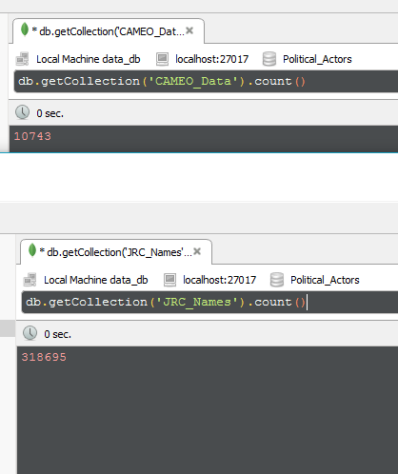
3,423,740,385,000 approx.. String comparisons needed for finding relation

Slide 12
Implementation using Edit Distance
Done using Edit Distance
Insertion or Deletion : 1
Substitution : 1
Cameo-JRC join script on a small data set of 219 entities
out of which 147 are person names which have a chance of being in JRC
# of Cameo Entity Matched | 0 Edit Distance(Exact Match) | 1 Edit Distance | 2 Edit Distance | 3 Edit Distance | 4 Edit Distance
219 (# of persons 147) | 54 | 199 (145) | 429 (230) | 1115 | 8163
False Positive (connection not detected found by manual lookup) | >50 | ~14
False Negative | 0 | 21 | > 100 | > 60 %

Slide 13
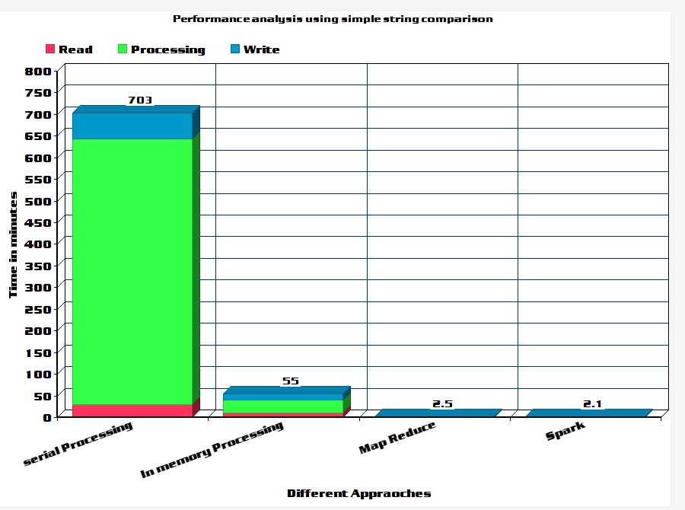
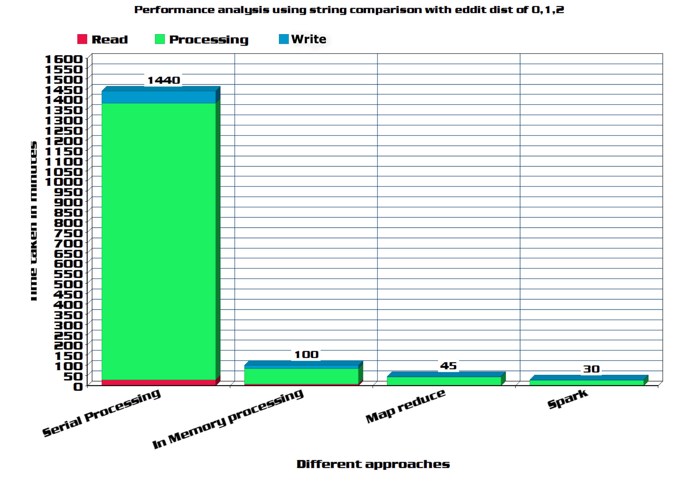
Performance Analysis of Many to many joins

Slide 14
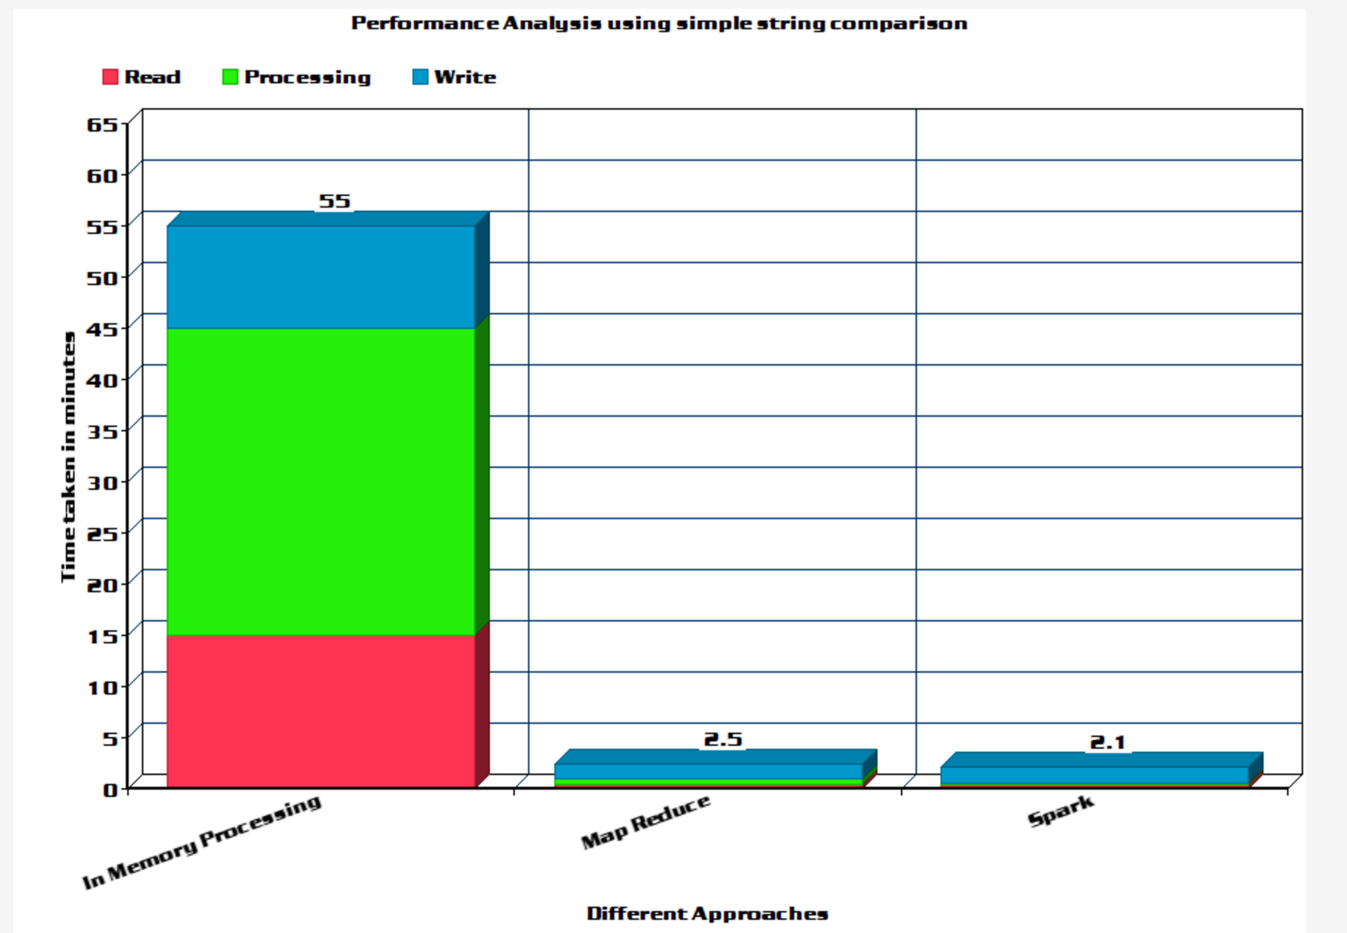
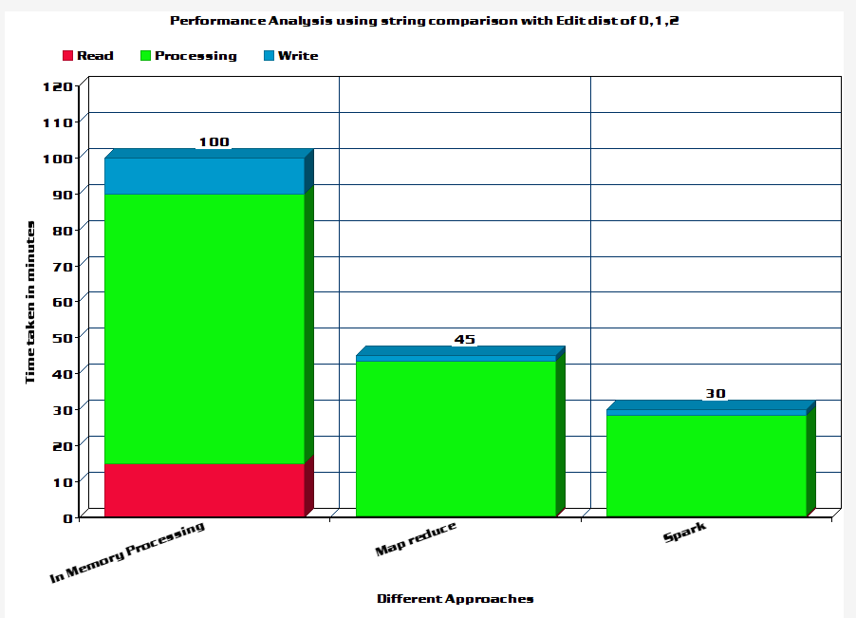
Performance Analysis of Many to many joins

Slide 15
Demo 2

Slide 16
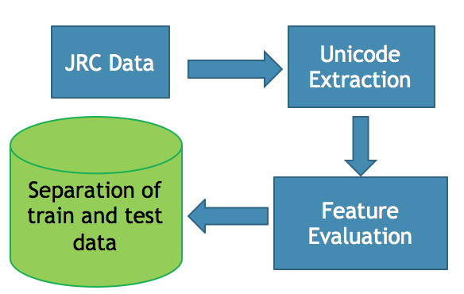
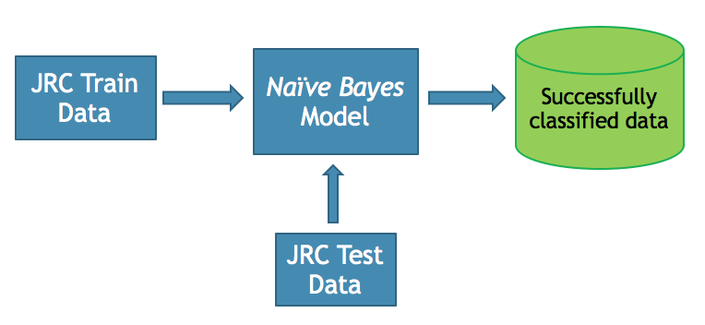
Supervised Learning for language detection
Process: Given the list of names, we identify features based on the unicodes of the characters in each name. We generate a set of uni codes for each string. Features like mean, median, mode, range, highest, lowest of the code point set of the string helps us to identify range of unicodes. Each language has a range of unicodes given to its characters. Based on this information, Naïve Bayes classifier buckets each string to a language.
Feature : Identified features like mean, median, highest, lowest, range of the code point value set of each string.
Accuracy : We see an accuracy of 74.95% based on the repeated experimental results.

Slide 17
Experiments & Result with Discussion
Naive Bayes is a simple multiclass classification algorithm with the assumption of independence between every pair of features. Naive Bayes can be trained very efficiently.
Within a single pass to the training data, it computes the conditional probability distribution of each feature given label, and then it applies Bayes’ theorem to compute the conditional probability distribution of label given an observation and use it for prediction.
We worked on a dataset with 659895 records of which 588245 records have languages unrecognized and the remaining recognized.
Training data : we have 71650 training records. As you can observe it is limited in comparison with the test data
Accuracy : After running the experiment five times in batches , each batch with 50000 test record we observed an average accuracy of 74.95%.
Time taken : Each batch took about 133.57 seconds in average to execute successfully

Slide 18
ML Output
Training Data size (71650 records)
Experiment No | Test data size | Time taken In seconds | Accuracy
1 | 50000 | 132.06 | 75.10
2 | 50000 | 135.42 | 77.01
3 | 50000 | 133.97 | 73.38
4 | 50000 | 132.05 | 76.04
5 | 50000 | 134.37 | 73.24

Slide 19
Future work
Allow along with name, get more different attributes.
Dynamically update the database with new updates regarding new Persons and Change in Positions.
Use SVM, K-means for language detection in JRC dataset.
Use Lucene indexed Babble-net dataset to extract more data.
Using cross validation like k-fold method for better results. We can explore other features like statistic quantiles like standard deviation, variance , inter quantile range, quartiles for feature selection.
We can try using more powerful machine learning techniques like ensemble methods for building the model.

Slide 20
Reference
CAMEO Data: https://github.com/openeventdata/UniversalPetrarch/tree/master/UniversalPetrarch/data/dictionaries
BableNet http://babelnet.org/
Code Repo : https://github.com/SubhasisDutta/JRC-Name-Parser
JRC Names https://ec.europa.eu/jrc/en/language-technologies/jrc-names
Ralf Steinberger, Bruno Pouliquen, Mijail Kabadjov, Jenya Belyaeva & Erik van der Goot, JRC-NAMES: A Freely Available, Highly Multilingual Named Entity Resource
JRC Names https://ec.europa.eu/jrc/en/language-technologies/jrc-names
Ralf Steinberger, Bruno Pouliquen, Mijail Kabadjov, Jenya Belyaeva & Erik van der Goot, JRC-NAMES: A Freely Available, Highly Multilingual Named Entity Resource

Slide 21
Thank You

